Slide 1

Computer Architecture
Lecture – 4

Slide 2

Discussed individual functional units of the computer.
But to form a fully computational unit, they must be connected and organized in a proper way.
Sumaiya Iqbal, Lecturer, CSE, BUET

Slide 3

The functional units of the computer must be organized so that all its units can handle one full word of data in a given time.
When a word of data is transferred between two units, all the bits are transferred simultaneously at the same time, over many wires/lines, one bit/wire.
Such a group of lines serving as a connecting path is called a bus.
Sumaiya Iqbal, Lecturer, CSE, BUET

Slide 4
Bus not only carries data, but also addresses and control signals.
The simplest way to inter connect functional units(includes I/O devices) is to use a single bus.
But then , that bus can be used for only one transfer at a time actively between two units.
So, only two units can access that bus at a single time.
Sumaiya Iqbal, Lecturer, CSE, BUET

Slide 5
Reasons for using single bus :
  Single bus means, lower number of wires, so low cost.
  Ease of adding an input or output device.
  Flexibility of adding a new input or output device.
Problems of single bus(Advantage of using multiple buses) :
  Can not support concurrent transfers to be carried out at the same time.
Sumaiya Iqbal, Lecturer, CSE, BUET

Slide 6
  Cost is increased due to the increase of wires.
  Can achieve lower performance than multiple bus structure.
Now, speed of operation of all the functional units are not same.
  Memory and processor operates at electronic speed, so the fastest part of the computer.
  But the peripherals that is I/O devices are relatively slow.
Sumaiya Iqbal, Lecturer, CSE, BUET

Slide 7
  Since in a single bus structure, all the devices have to communicate over that single bus, an efficient way is required to make these slow I/O devices compatible with faster units.
  A common approach to smooth out this differences in speed is to use another special storage, called buffer register.
  The task of the buffer register(with each I/O device) is to hold data during transfer.
Sumaiya Iqbal, Lecturer, CSE, BUET

Slide 8
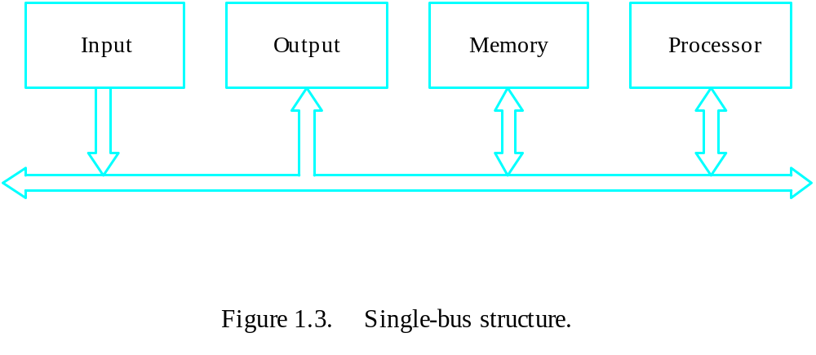
Sumaiya Iqbal, Lecturer, CSE, BUET

Slide 9
Example of using a buffer register :
  Assume, we have to print a character.
  The processor sends the encoded character over the bus to the printer buffer register.
  Since, register can operate in electronic speed, this transfer takes less time, because according to speed, buffer register is compatible with the processor.
Sumaiya Iqbal, Lecturer, CSE, BUET

Slide 10
  After the buffer is loaded, printer cam slowly print it, then there no problem is created due to the slow printer.
  And the processor also need not wait for the printer to finish its job.
  After giving the character the to buffer register, it ca go back to its next task.
  So, here the buffer register with the printer is used to smooth out the speed difference.
Sumaiya Iqbal, Lecturer, CSE, BUET

Slide 11

Since, in this single bus structure, three types of information(data, address and control signal) is passed through this single bus,
  It consists of three sets of wires to carry data, address and control signal.
  Each I/O device has a unique address.
  To access a particular I/O device, the processor places the address of that device on the address line.
Sumaiya Iqbal, Lecturer, CSE, BUET

Slide 12
  The device corresponding to the device recognizes its address.
  Responds to the command issued in the control signal on the control information lines.
  The processor requests either read or write operation.
  The requested data is then transferred over the data lines.
Sumaiya Iqbal, Lecturer, CSE, BUET

Slide 13

Processor
Memory
Bus
I/O de
vice 1
I/O de
vice
n
Figure 4.1. A single-bus structure.
Sumaiya Iqbal, Lecturer, CSE, BUET

Slide 14
Memory-mapped I/O :
  If memory and I/O devices share the same address space , the arrangement is called memory-mapped I/O.
  DATAIN is the address of the input buffer and DATAOUT is the address of the output buffer of an I/O device.
  For example, if Move DATAIN, R0 is an instruction, then it transfers the content of the
Sumaiya Iqbal, Lecturer, CSE, BUET

Slide 15
  memory address DATAIN associated with the input buffer of some input device(say, keyboard) into Ro register.
  Similarly, Move Ro, DATAOUT instruction moves the content of Ro register into the memory location DATAOUT, associated with the output buffer of some output device(say monitor).
  Most of the computer system use memory-mapped I/O because it leads to a simpler s/w.
Sumaiya Iqbal, Lecturer, CSE, BUET

Slide 16
  Some processor has special instruction for I/O operation(IN/OUT) and has a separate 16 bit address space for I/O device.
  One advantage of it is I/O devices can be accessed through fewer address lines.
  But, one important concept is, this I/O address lines for such processor is not separate from the memory address line.
Sumaiya Iqbal, Lecturer, CSE, BUET

Slide 17
  When a special control signal for I/O access is asserted, I/O devices examine the lower order bits of the address bus.
  H/W requirements to connect an I/O device with the bus :
  Address Decoder :
    Enables the I/O device to recognize its corresponding address when its address appears in the address lines.
    Connected to the address lines of the bus.
Sumaiya Iqbal, Lecturer, CSE, BUET

Slide 18
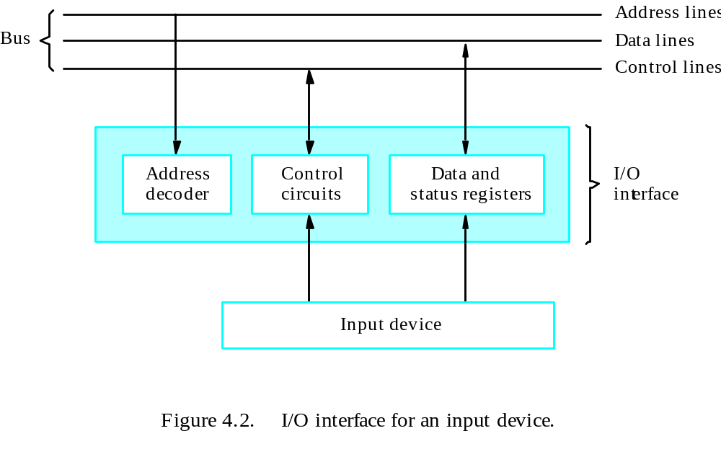
Sumaiya Iqbal, Lecturer, CSE, BUET

Slide 19
  Data and Status Register :
    The data register holds the data being transferred to or from the processor.
    The status register contains information relevant to the operation of I/O devices.
    Both the data and status registers are connected to the data bus and the I/O device.
    Each of these registers are assigned a unique address.
  Control Circuits :
    Coordinates the total I/O transfer operation.
Sumaiya Iqbal, Lecturer, CSE, BUET

Slide 20
  This address decoder, data register, status register and the control circuitry constitutes the I/O device’s interface circuit.
  Some other basic idea’s for performing I/O operation :
    SIN Flag : Status flag, part of the status register. This flag is set to 1, when there is some data in the input buffer of an input device, otherwise cleared to 0.
    SOUT Flag :Status flag, part of the status register. This flag is set to 1, when there is some data in the output buffer of an output device, otherwise cleared to 0.
Sumaiya Iqbal, Lecturer, CSE, BUET

Slide 21
Example : Write a program that takes a line of characters one by one as input and show them in any output device.
Solution :
  The 4 registers, DATAIN, DATAOUT, STATUS, CONTROL are involved in any I/O operation.
  Only two flags, SIN and SOUT is necessary in this example.
Sumaiya Iqbal, Lecturer, CSE, BUET

Slide 22
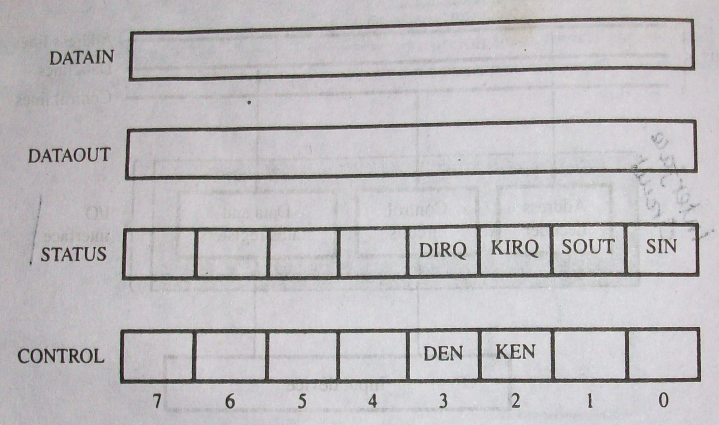
Sumaiya Iqbal, Lecturer, CSE, BUET

Slide 23
  Others bits in the STATUS and CONTROL registers(DIRQ, KIRQ, DEN, KEN) are not needed to be discussed for this problem.
  Data from the input device(say, keyboard) are available in the DATAIN register, and
  Data that is to be shown in a output device(say, monitor) is sent the DATAOUT register.
Sumaiya Iqbal, Lecturer, CSE, BUET

Slide 24
 | Move | #LINE, R0 | Initialize memory pointer
WAITK | TestBit | #0, STATUS | Test SIN(0th bit of STATUS register)
 | Branch = 0 | WAITK | Wait for character to be entered
 | Move | DATAIN, R1 | Read character
WAITD | TestBit | #1, STATUS | Test SOUT(1st bit of STATUS register)
 | Branch = 0 | WAITD | Wait for display to become ready
 | Move | R1, DATAOUT | Send character to display
 | Compare | #$0D, R1 | Check if carriage return
 | Branch ≠ 0 | WAITK | If not, get another character
 | Move | #$0A, DATAOUT | Otherwise, send Line Feed
 | Call | PROCESS | Calls a subroutine to process the input line
Sumaiya Iqbal, Lecturer, CSE, BUET

Slide 25
  In the above program, R0 acts as a pointer to the character to be taken as input from keyboard.
  The memory location of the start of the line of character is #LINE.
  Now, in the following program, we make a slight change, that is, read the line of character from keyboard, store it in a memory location(buffer) and then display it into monitor(Self Study).
  A single line is to be added to store the character in the R1 into the memory location pointed by R0.
Sumaiya Iqbal, Lecturer, CSE, BUET

Slide 26
 | Move | #LINE, R0 | Initialize memory pointer
WAITK | TestBit | #0, STATUS | Test SIN(0th bit of STATUS register)
 | Branch = 0 | WAITK | Wait for character to be entered
 | Move | DATAIN, R1 | Read character
WAITD | TestBit | #1, STATUS | Test SOUT(1st bit of STATUS register)
 | Branch = 0 | WAITD | Wait for display to become ready
 | Move | R1, DATAOUT | Send character to display
 | Move | R1, (R0)+ | Store character and advance the pointer
 | Compare | #$0D, R1 | Check if carriage return
 | Branch ≠ 0 | WAITK | If not, get another character
 | Move | #$0A, DATAOUT | Otherwise, send Line Feed
 | Call | PROCESS | Calls a subroutine to process the input line
Sumaiya Iqbal, Lecturer, CSE, BUET

Slide 27
  The above I/O operation is called program-controlled I/O.
    Where the processor repeatedly checks the status flag to maintain the synchronization between processor and I/O device.
    So, here the processor polls the device.
    There are other two mechanism for implementing I/O operation(Interrupts and Direct Memory Access) which will be discussed later.
Sumaiya Iqbal, Lecturer, CSE, BUET

Slide 28

Zaky(Chapter 1 : 1.4)
Zaky(Chapter 4 : 4.1)
Class Lecture
Sumaiya Iqbal, Lecturer, CSE, BUET

